Slide 1


Todd From Osaka
January 25th, 2023

Slide 2

Outline
Executive Summary
Introduction
Methodology
Results
Conclusion
Appendix
<number>
Notes:
<number>

Slide 3
Executive Summary
For this project, we set out to find whether we could predict whether the Space-X Falcon 9 rocket would land successfully (and therefore be able to be re-used). In order to obtain the data to try and predict this, we used the Space-X API as well as webcrawling to get the data. We then explored the data visually, to look for correlations between inputs (launch location, payload weight, etc) and landing success. We finally built a model to predict (with great accuracy), whether Falcon 9 would land successfully.
Regarding results, it appears that we can predict whether Falcon 9 will land successfully simply using data on the launch site, height of orbit, payload mass, etc.
2

Slide 4
Introduction
At SpaceY, we want to bid competitively on rocket launching contracts, so we need the best data available on the prices of our competitors.
Our main competitor is Space-X, who routinely use their Falcon-9 rocket to send payloads to space. They charge their customers about 62 million dollars for this service. If they happen to lose the Falcon-9 rocket in the process (meaning, it does not land successfully, and therefore cannot be re-used in a future mission), the cost goes up, and they pass that cost on to the customer.
We at SpaceY would like to offer rocket launching services at a price just below those of Space-X. But, what will be the bid price that Space-X offers for a certain launch? We’d like to undercut that just a bit, and therefore win the bid.
If we could predict in advance whether the Falcon 9 will land successfully, we can know the Space-X bid price in advance. Knowing that, we will be able to undercut the bid and win the contract.
But is that even possible—to predict whether the Falcon 9 will return to earth in one piece, even before it launches? It turns out it is very possible, and can be predicted using the data and methodologies outlined in this report.
3

Slide 5

Section 1
4

Slide 6
Methodology
Executive Summary
Data collection:
Data was collected via the Space-X API, which provides statistics on every Space-X launch. Also, additional data was scraped from the internet, specifically WikiPedia.
Data processing:
Much of the data was textual (like “False Ocean” for an unsuccessful ocean landing, and “True Ocean” for a successful one), so we had to convert all of this kind of fuzzy textual data into zeros and ones (for the computer to understand it)
Exploratory data analysis:
We explored the data using Seaborn (a Python data visualization library) as well as SQL queries.
Interactive visual analytics
Using Folium (a Python map-creating library), we tried to discover correlations between launch site and landing success. Also, Plotly Dash was used to create an interactive web-based dashboard for data exploration.
Perform predictive analysis using classification models
Finally, we tested (in-sample and out-of-sample) a number of machine learning models, and found the most accurate one.
4
Notes:
<number>

Slide 7
Data Collection
Data was collected both from Space-X, as well as web sources (WikiPedia). Using the Python requests library, and Beautiful Soup, we successfully gathered tabular data about a number of Space-X past launches.
Gather data from
the Space-X API
Put the data
Into a Pandas
Dataframe,
Then into a
CSV file
Gather data from
WikiPedia
(web crawling)
6

Slide 8
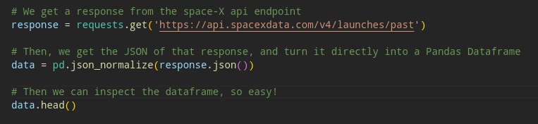
Data Collection – SpaceX API
We used Python’s requests library to make calls to the SpaceX API and get JSON packets in return. Everything is possible in about 3 lines of code, as shown below, it’s so easy.
Source code is here: https://github.com/todbott/jupyter-for-ibm/blob/master/Data%20Science%20Capstone/jupyter-labs-spacex-data-collection-api.ipynb
<number>

Slide 9
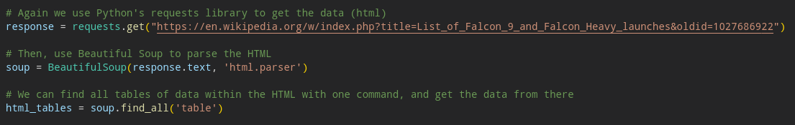
Data Collection - Scraping
Web scraping (using Beautiful Soup) is also an easy process, as shown in the following lines of code. We successfully got supplementary data from WikiPedia using this method.
Source code is here:
8

Slide 10
Data Wrangling
In the raw data (from the API and the internet), there was a lot of text. For example, a successful ocean landing was signified by “True Ocean”, and an unsuccessful one was signified by “False Ocean”. There were many other such problems.
In order to prepare the data for visualization, we had to ‘one-hot encode’ all such textual data. Also, some data was missing, so we had to interpolate it using the average of the data column from which it came.
Source code is here:
9

Slide 11
EDA with Data Visualization
During our exploratory data analysis, we used Seaborn to plot many figures, to look for correlations visually.
We thought there may be some kind of correlation between successful landings and orbit height, or orbit type and payload weight, so we plotted those as scatter plots, among other charts.
Source code is here:
10

Slide 12
EDA with SQL
We used SQL to perform many queries to explore the data, they are listed below. Source code is here:
SELECT DISTINCT(Launch_Site) FROM spacex
SELECT Launch_Site FROM spacex WHERE Launch_Site LIKE "CCA%" LIMIT 5
SELECT SUM(PAYLOAD_MASS__KG_) FROM spacex WHERE Customer="NASA (CRS)"
SELECT AVG(PAYLOAD_MASS__KG_) FROM spacex WHERE Booster_Version="F9 v1.1"
SELECT MIN(DATE) FROM spacex WHERE Landing_Outcome="Success (ground pad)"
SELECT DISTINCT(Booster_Version) FROM spacex WHERE Landing_Outcome="Success (drone ship)" AND PAYLOAD_MASS__KG_ BETWEEN 4000 AND 6000
SELECT COUNT(*) FROM spacex WHERE Landing_Outcome LIKE "Success%"
SELECT DISTINCT(Booster_Version) FROM spacex WHERE PAYLOAD_MASS__KG_ = (SELECT MAX(PAYLOAD_MASS__KG_) FROM spacex)
SELECT Landing_Outcome, Booster_Version, Launch_Site FROM spacex WHERE Date LIKE "%2015"
SELECT COUNT(Landing_Outcome), Landing_Outcome FROM spacex WHERE Date BETWEEN "2010-04-06" AND "2017-03-20" GROUP BY Landing_Outcome ORDER BY COUNT(Landing_Outcome) DESC
11

Slide 13
Build an Interactive Map with Folium
Using Folium, we made interactive maps showing the location of each launch site, as well as markers indicating how many successful and unsuccessful landings were associated with launching from that site.
We also looked at distance to the coast, distance to major roadways, and distance to cities, for each launch site.
Source code is here:
12

Slide 14
Build a Dashboard with Plotly Dash
Plotly allowed us to build an interactive web-based dashboard, showing the percent of successful landings associated with each launch site, as well as a scatter plot showing payload weight vs. landing success (which is filterable, so different payload ranges can be selected and viewed).
Source code is here:
13

Slide 15
Predictive Analysis (Classification)
Once all the data was assembled, we set out to predict the outcome of the landing (successful or not successful) based on the data.
We used a number of machine learning models for classification, and found that a decision tree was the best choice, and was able to classify the landing outcomes with high accuracy.
Each model was tuned, trained and tested using the following workflow:
Source code is here:
Grid search to
Find the best
parameters
Splitting the data
Into training and
Testing sets
Training the model
On the training
data
Testing the model
On the testing
Data, resulting
In an accuracy score
14

Slide 16
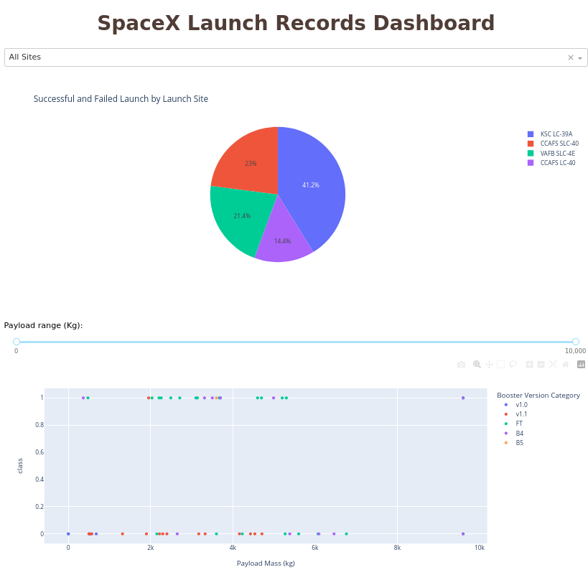
Results
We found a few interesting correlations between payload mass and landing success, as well as orbit height and landing success. Others, such as the number of previous flights, and how often the rocket had been re-used also proved to be important in predicting future outcomes.
Our Plotly Dash interactive dashboard helped to find trends in the data, as well:
Finally, we found that a Decision Tree could predict whether landings would be successful or not, based on only 12 specific input features.
16
Notes:
<number>

Slide 17

Section 2

Slide 18
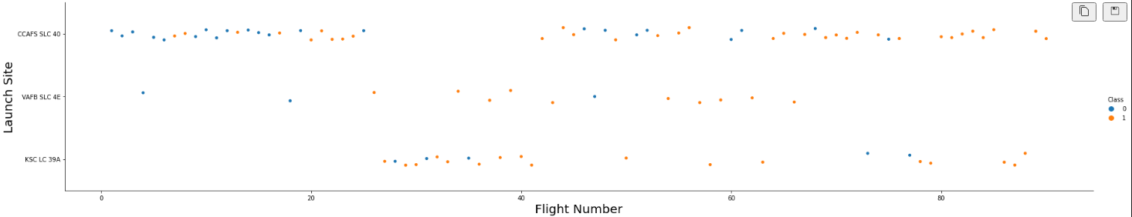
Flight Number vs. Launch Site
Looking at Flight Number vs. Launch Site, we can see that successful landings became more likely as flight number went up, across all launch sites (successful landings are indicated in orange). This seems to make sense—with more experience, greater success was possible.
16

Slide 19
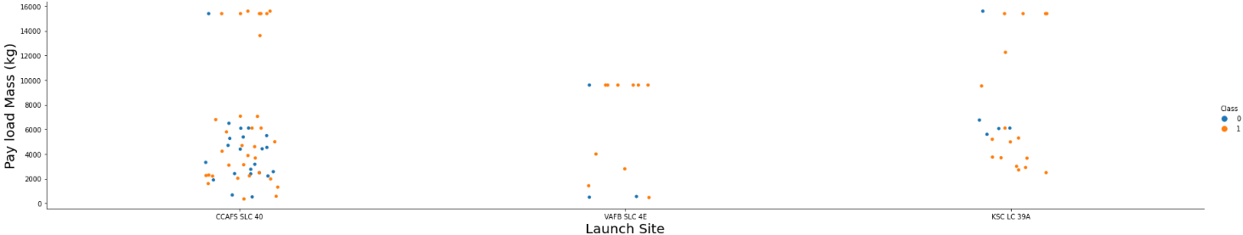
Payload vs. Launch Site
Looking at payload weight vs. Launch Site, we can see that the launch site on the far right has the highest ratio of successful landings (indicated in orange). Also, the middle launch site never launches a rocket with a payload greater than 10,000 kg, which is interesting.
18

Slide 20
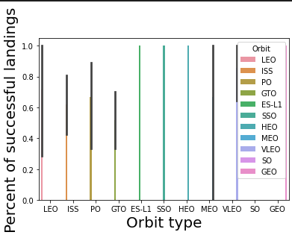
Success Rate vs. Orbit Type
Looking at landing success rate vs. Orbit type, we can see that rockets launched into GTO orbit have the lowest successful landing rate, while many other orbits result in successful landings most often.
19

Slide 21
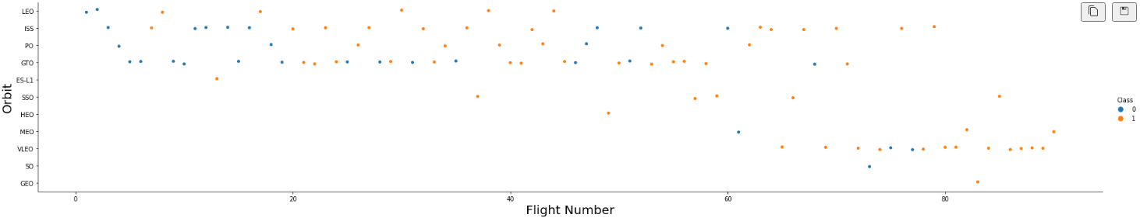
Flight Number vs. Orbit Type
Looking at Flight Number vs. Orbit type, we can see that, in the case of VLEO (very low earth orbit), the number of successful landings (signified by orange) increases as flight number increases. This is marked with a green elipsis in the figure below.
20

Slide 22
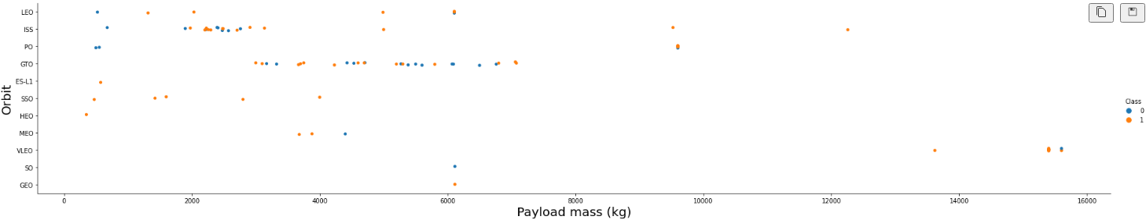
Payload vs. Orbit Type
Looking at payload weight vs. Orbit type, nothing really becomes apparent, except for the fact that the most rockets have been launched into GTO orbit, with about the same number of successful and unsuccessful landings.
21

Slide 23
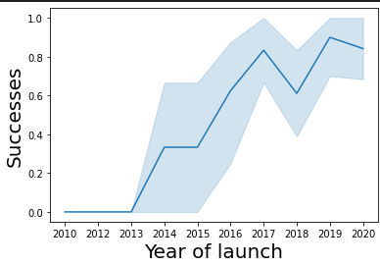
Launch Success Yearly Trend
Looking at the number of successful landings over the years, we can see that it increases from 2013 to 2020, with a small dip in 2018. This makes sense, as greater experience would seem to cause greater success.
22

Slide 24
All Launch Site Names
SELECT DISTINCT(Launch_Site) FROM spacex
This SQL statement returns all launch site names (with no repeats). The output is:
[('CCAFS LC-40',), ('VAFB SLC-4E',), ('KSC LC-39A',), ('CCAFS SLC-40',)]
This tells us that there are 4 launch sites. The first and last may be near each other, as their names are similar.
23

Slide 25
Launch Site Names Begin with 'CCA'
SELECT Launch_Site FROM spacex WHERE Launch_Site LIKE "CCA%" LIMIT 5
This SQL statement returns 5 launch site names that begin with CCA. The output is:
[('CCAFS LC-40',),
('CCAFS LC-40',),
('CCAFS LC-40',),
('CCAFS LC-40',),
('CCAFS LC-40',)]
This tells us that there were at least 5 launches from the CCAFS LC-40 site.
24

Slide 26
Total Payload Mass
SELECT SUM(PAYLOAD_MASS__KG_) FROM spacex WHERE Customer="NASA (CRS)"
This SQL statement returns The total payload mass carried on behalf of NASA so far. The output is:
[(45596,)]
This tells us that 45,596 kilograms of stuff has been carried into orbit for NASA, by Space-X. This seems like a high number, but seems to make sense, as NASA is a big player in the space industry.
25

Slide 27
Average Payload Mass by F9 v1.1
SELECT AVG(PAYLOAD_MASS__KG_) FROM spacex WHERE Booster_Version="F9 v1.1"
This SQL statement returns the average payload mass carried by rockets with the F9 v1.1 version booster. The output is:
[(2928.4,)]
This tells us that the Falcon 9 v1.1 booster can carry about 2,928 kilograms into orbit. It may be good to compare this with other versions of the booster.
26

Slide 28
First Successful Ground Landing Date
SELECT MIN(DATE) FROM spacex WHERE Landing_Outcome="Success (ground pad)"
This SQL statement returns the first date that Space-X obtained a successful ground landing. The output is:
[('01-05-2017',)]
This is extremely interesting, as the data goes back all the way to 2013. That means that, in the first 4 years of experimentation, there was not a single successful ground landing. That is surprising.
27

Slide 29
Successful Drone Ship Landing with Payload between 4000 and 6000
SELECT DISTINCT(Booster_Version) FROM spacex WHERE Landing_Outcome="Success (drone ship)" AND PAYLOAD_MASS__KG_ BETWEEN 4000 AND 6000
This SQL statement returns the booster version (with no repeats) of rockets that made successful landings on drone ships, and had a payload of between 4000 and 6000 kg. The output is:
[('F9 FT B1022',), ('F9 FT B1026',), ('F9 FT B1021.2',), ('F9 FT B1031.2',)]
This tells us that Booster v1.02 to v1.03 were very good at landing on ships.
28

Slide 30
Total Number of Successful and Failure Mission Outcomes
SELECT COUNT(*) FROM spacex WHERE Landing_Outcome LIKE "Success%"
SELECT COUNT(*) FROM spacex WHERE Landing_Outcome LIKE "Failure%"
These SQL statements count the number of successful and unsuccessful landings. The output is:
61 (for success) and 10 (for failure)
This tells us that there have been more successful landings than failed ones.
29

Slide 31
Boosters Carried Maximum Payload
SELECT DISTINCT(Booster_Version) FROM spacex WHERE PAYLOAD_MASS__KG_ = (SELECT MAX(PAYLOAD_MASS__KG_) FROM spacex)
This SQL statement returns the strongest boosters (with no repeats). The output is:
[('F9 B5 B1048.4',), ('F9 B5 B1049.4',), ('F9 B5 B1051.3',), ('F9 B5 B1056.4',), ('F9 B5 B1048.5',), ('F9 B5 B1051.4',), ('F9 B5 B1049.5',), ('F9 B5 B1060.2 ',), ('F9 B5 B1058.3 ',), ('F9 B5 B1051.6',), ('F9 B5 B1060.3',), ('F9 B5 B1049.7 ',)]
This tells us that there are many booster types, at least.
30

Slide 32
2015 Launch Records
SELECT Landing_Outcome, Booster_Version, Launch_Site FROM spacex WHERE Date LIKE "%2015"
This SQL statement returns the landing outcome, booster version, and launch site from all launches in the year 2015. The output is:
[('Failure (drone ship)', 'F9 v1.1 B1012', 'CCAFS LC-40'),
('Controlled (ocean)', 'F9 v1.1 B1013', 'CCAFS LC-40'),
('No attempt', 'F9 v1.1 B1014', 'CCAFS LC-40'),
('Failure (drone ship)', 'F9 v1.1 B1015', 'CCAFS LC-40'),
('No attempt', 'F9 v1.1 B1016', 'CCAFS LC-40'),
('Precluded (drone ship)', 'F9 v1.1 B1018', 'CCAFS LC-40'),
('Success (ground pad)', 'F9 FT B1019', 'CCAFS LC-40')]
This tells us that there was only 1 success in 2015, which is interesting.
31

Slide 33
Rank Landing Outcomes Between 2010-06-04 and 2017-03-20
SELECT COUNT(Landing_Outcome), Landing_Outcome FROM spacex WHERE Date BETWEEN "2010-04-06" AND "2017-03-20" GROUP BY Landing_Outcome ORDER BY COUNT(Landing_Outcome) DESC
This SQL statement returns the landing outcomes between 2 dates, and their frequency. The output is:
[(10, 'No attempt'), (5, 'Success (drone ship)'), (5, 'Failure (drone ship)'),
(3, 'Success (ground pad)'), (3, 'Controlled (ocean)'), (2, 'Uncontrolled (ocean)'),
(2, 'Failure (parachute)'), (1, 'Precluded (drone ship)')]
This tells us that the most frequent landing type was ‘No attempt’ between these 2 dates. It would be interesting to research exactly what that means.
32

Slide 34

Section 3

Slide 35
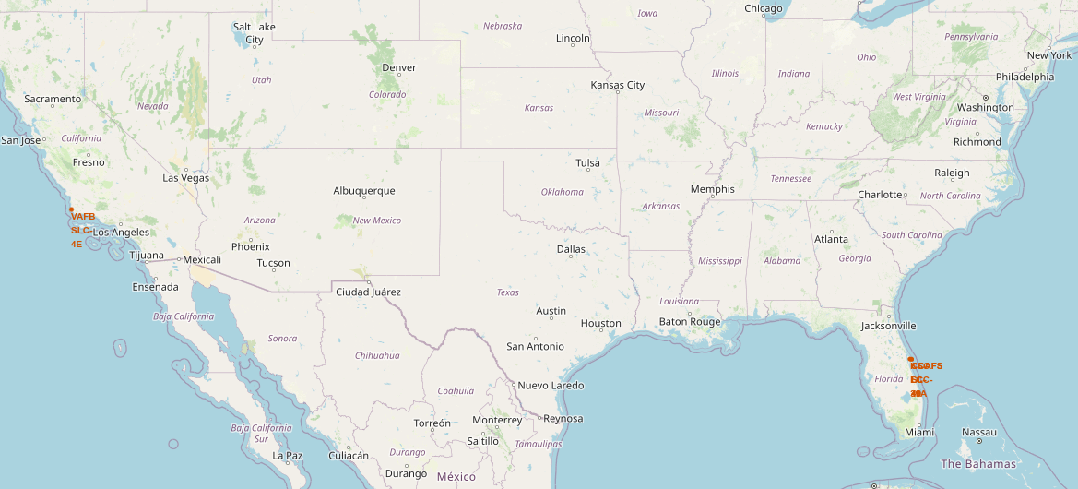
Launch Site Locations: Where are they exactly?
The launch sites are actually on both coasts (California and Florida). There are none in Texas (as NASA has theirs).
33

Slide 36
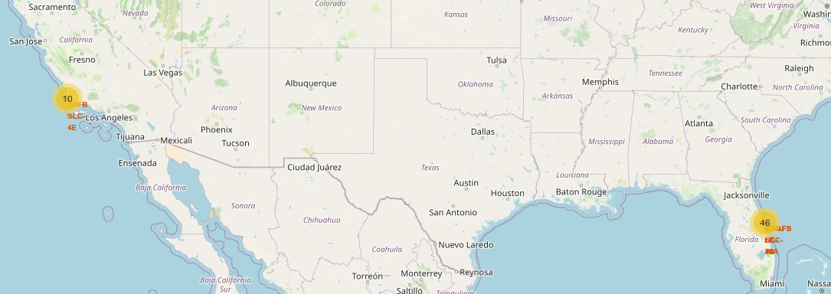
<Folium Map Screenshot 2>
As we can see by adding map markers, there have been 10 launches from California, and 46 from Florida.
35

Slide 37
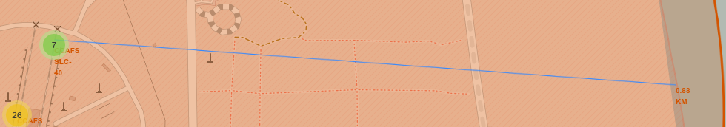
<Folium Map Screenshot 3>
Drilling down, we can calculate the distance to the coast and other major landmarks from each launch site. Here, we can see that a launch site in Florida is 0.88 km from the coast. Also, it has been associated with 7 successful landings (as noted by the green circle with the number 7).
36

Slide 38

Section 4

Slide 39
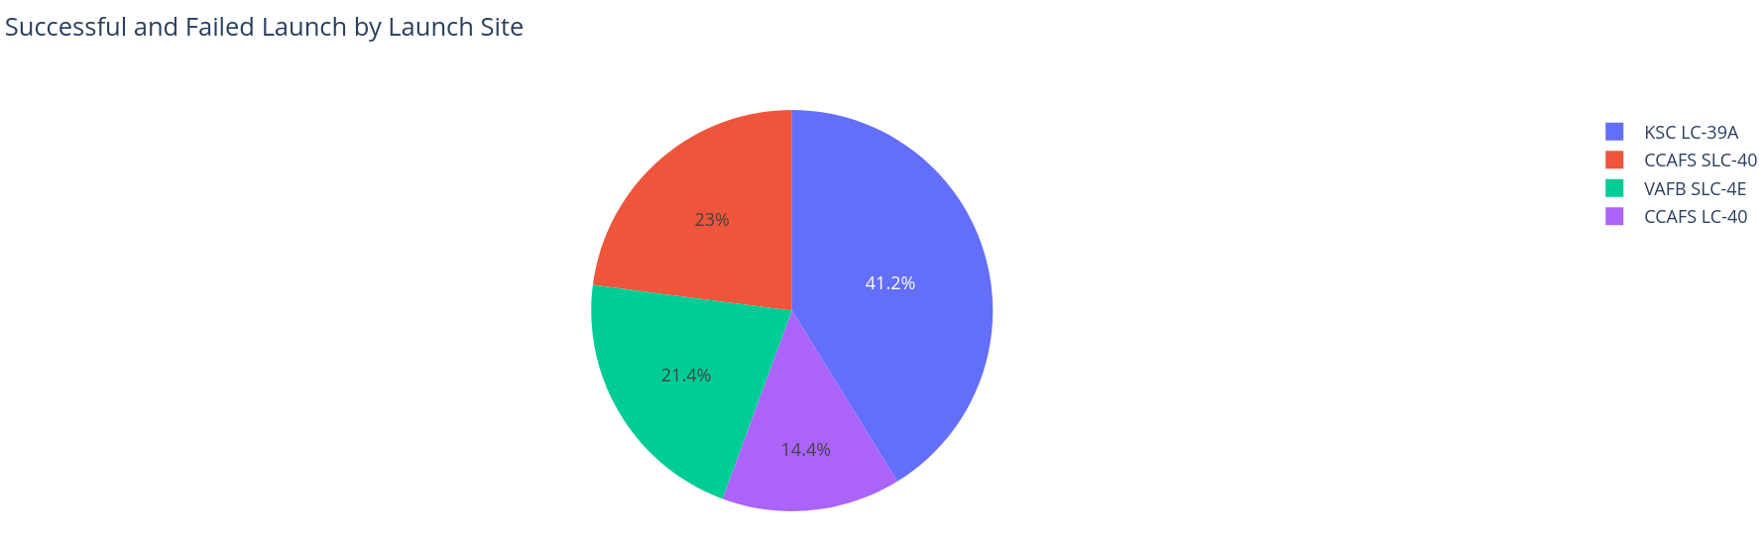
Data Filtering & Visualization with Plotly Dash
Using Plotly, we can see data as it is filtered. Here, we see our dashboard, which shows a pie chart of successful launches by launch site. We can see that the most successful launches are associated with KSC LC-39A.
<number>

Slide 40
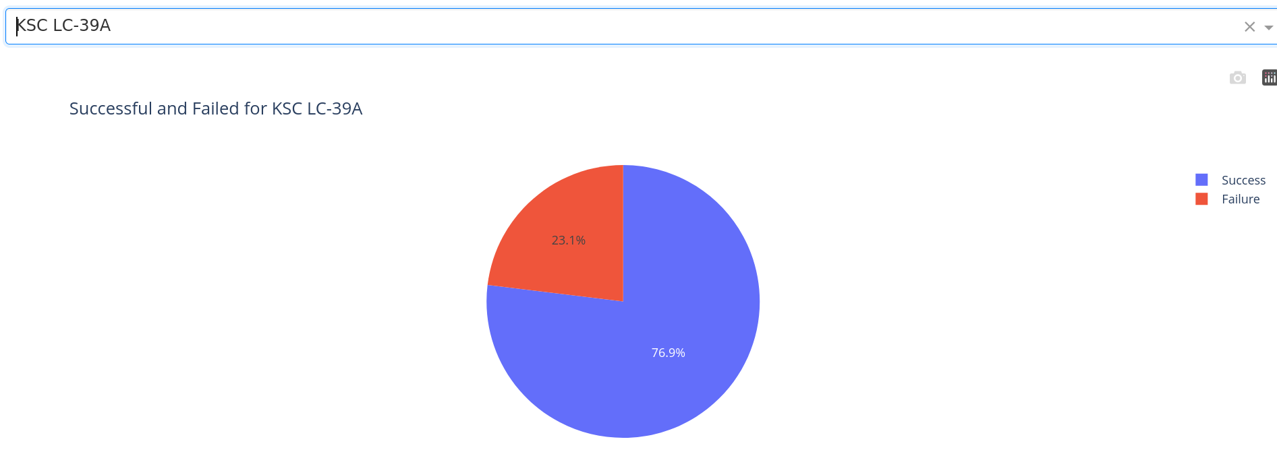
Drilling Down to Specific Launch Sites
By filtering by that launch site, we can see what percentage of launches from that site resulted in successful vs. unsuccessful landings.
<number>

Slide 41
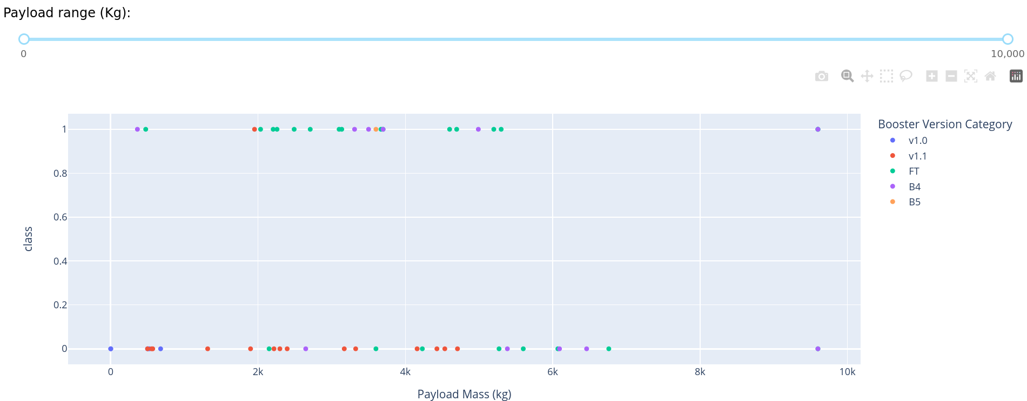
What about Payload Weight?
Using this interactive slider and scatterplot, we can determine which booster versions and payload weights were associated with successful and unsuccessful landings. The “Launch site” dropdown also affects this scatterplot, so we can see stats for each launch site.
<number>

Slide 42

Section 5

Slide 43
Classification Accuracy
We tested
<number>

Slide 44
Confusion Matrix
Show the confusion matrix of the best performing model with an explanation
43

Slide 45
Conclusions
Point 1
Point 2
Point 3
Point 4
…
44

Slide 46
Appendix
Include any relevant assets like Python code snippets, SQL queries, charts, Notebook outputs, or data sets that you may have created during this project
45
Notes:
<number>

Slide 47


